Slide 1

LLM-Assisted Abstract Screening for Youth Homelessness Interventions
Karikarn (Kay) Chansiri, Ph.D.
Senior Researcher in HCI and AI

Slide 2
Why Abstract Screening?
Abstract screening is the first step to ensure high-quality evidence.
Process is challenging — requires sifting through large volumes of studies.
Human screening is prone to fatigue, attrition, and bias, threatening validity.
Systematic reviews (SRs) are resource-intensive (≈1 year, $100K+ to complete).
High-quality SRs guide clinical practice, decision-making, and policy.

Slide 3
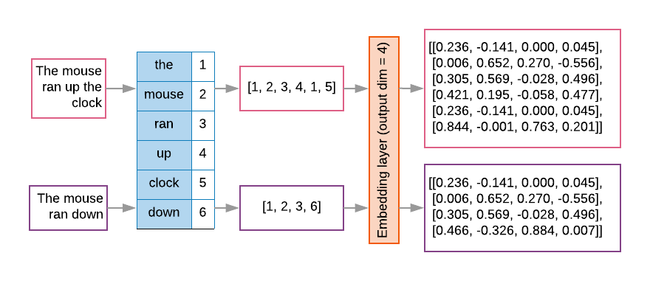
Development of AI-Assisted SRs
1. The NLP Era • NLP-Based Approach: Abstract text was preprocessed and vectorized using Bag of Words, TF-IDF, Sentence-BERT, Doc2Vec, or LSTM networks. • Classical ML Models: Support Vector Machines (SVM), Random Forests (RF), and Bayesian Networks were then trained on vectorized data to classify abstracts. • Limitation: Accuracy depended heavily on a large, well-curated labeled training set, making results sensitive to data quality and researcher bias.
Image citation

Slide 4
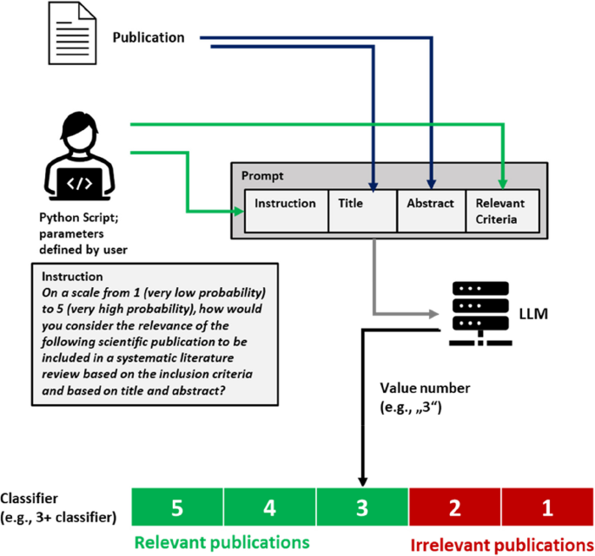
Development of AI-Assisted SRs
2. Hybrid Era • LLM + NLP Integration: Transformer models (e.g., BART encoder–decoder) were used to screen a subset of abstracts, generating training data for traditional ML models. • Outcome: Enabled semi-automated screening but remained dependent on training data quality and human judgment. • Challenges: Class imbalance and noisy labels reduced model performance. • Tools: Platforms such as Covidence and EPPI-Reviewer began integrating ML-assisted screening features.
Image citation

Slide 5
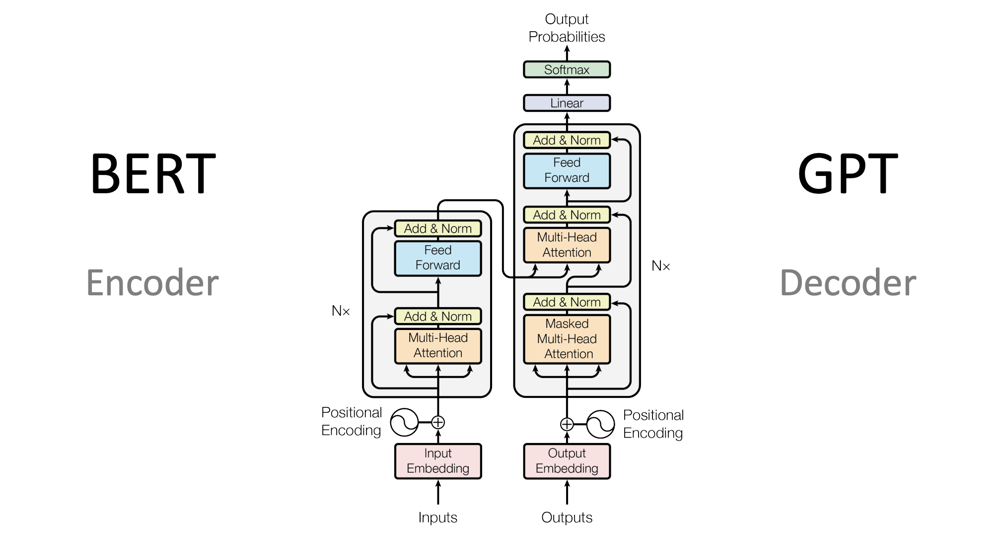
Development of AI-Assisted SRs
3. The LLM Era • Prompt Engineering: Use of zero-shot and few-shot prompts to classify abstracts directly. • Fine-Tuning: Task-specific fine-tuning and hyperparameter optimization improve recall and precision. • Advantages: Reduces reliance on large labeled datasets and increases adaptability across domains.
Image citation

Slide 6
Why prompt engineering is preferable?
Evidence-Based: MedPrompt (2023) shows that optimized prompting enables GPT-4 to outperform traditional fine-tuned models on medical benchmarks.
Low Cost: No expensive fine-tuning or infrastructure required.
Reusable: Prompts can be adapted and reused without advanced technical skills.
No Training Data Required: Eliminates the need for large, labeled datasets.
Robustness: Not affected by class imbalance or poor data quality.

Slide 7
Prompt Structure
Prompts should include three key elements: • Topic Statement: A concise description of the research question or focus area. • Eligibility Criteria: The exact inclusion/exclusion rules for study selection. • Abstract Text: The full text of the abstract to be evaluated.

Slide 8
1. Zero-shot prompt engineering^{1,2,3,4}
• Simple & Setup-Free: No examples or domain-specific training required. • Direct Classification: Categorizes abstracts without training a separate ML model. • Trade-Off: May slightly reduce sensitivity and risk omitting relevant studies. • Standardization Potential: Can assign LLM a “researcher” role for consistency. • Evidence: Research comparing GPT-4 to a “zero-shot + SVM” baseline show GPT-4 achieves significantly higher sensitivity (p < 0.001) with similar specificity.¹¹

Slide 9
Example 1¹
“You are a researcher rigorously screening titles and abstracts of scientific papers for inclusion or exclusion in a review paper. Use the criteria below to inform your decision. If any exclusion criteria are met or not all inclusion criteria are met, exclude the article. If all inclusion criteria are met, include the article.
{Inclusion Criteria}
{Exclusion Criteria}
{Abstract in investigation}
{Instructions}
Only type “YYY” for included articles or “XXX” for excluded articles
to indicate your decision. Do not type anything else”

Slide 10
Example 2⁵
“Act as an experienced medical researcher performing Title and Abstract screening for Umbrella Review, reviewing articles to decide if they should be included or excluded from your study. Each time you will receive the title and abstract for a paper along with a question that you have to answer based on the authors' work. Later on, your answers will help decide whether an article should be included or excluded so be precise while answering. If you are not sure, answer with 'uncertain’.
Inclusion questions:
1. "Is the study potentially designed as a systematic review and meta-analysis of randomized controlled trials?",
2. "Does the study's population include men and/or women age ≥ 50 years, community dwelling and/or institutionalized?",
3. "Is there an intervention of vitamin D, with or without Calcium supplementation?",
4. "Is the comparator vitamin D placebo or control? Or is this information uncertain? Explain"
Exclusion questions:
1. "Does the paper's population include pregnant women, individuals with advanced diseases like chronic liver failure, chronic renal failure, cancer, or individuals on steroids?",
2. "Does the paper primarily focus on active Vitamin D like calcitriol, or paricalcitol, or doxercalciferol, or alfacalcidol, or falecalcitriol, or 22-oxacalcitriol, or synthetic vitamin D or vitamin D analogues?"

Slide 11
Example 3²
“I would like you to help me with conducting a systematic review on {topic}. I will provide the title and abstract for one journal article and would like you to screen the paper for inclusion.
Here are the inclusion criteria: ….
Here is the abstract: ….”

Slide 12
Example 4²
“I seek assistance with a systematic review focused on animal depression. I’ll provide the abstract of a particular journal article and would appreciate an assessment for its inclusion based on the following criteria:
1….
2…
3…
and here are the exclusion criteria:
1…
2…
3…
Here is the abstract: …”

Slide 13
In addition to the standard zero-shot approach, studies have explored several alternative zero-shot strategies

Slide 14
1.1 Zero-shot ScreenPrompt
A method developed for a specific study¹
Adds study objectives directly into the prompt for context
Example 5: “Our systematic review is governed by the following objectives:… (description)…A study is considered included if it meets all the inclusion criteria. If a study meets any of the exclusion criteria, it should be excluded. Here are the two sets of criteria:
{Inclusion criteria}
{Exclusion Criteria}
{Abstract in investigation}
{Instructions, including task considerations}
# Instructions: We now assess whether the paper should be included from the systematic review by evaluating it against each and every predefined inclusion and exclusion criterion.
First, we will reflect on how we will decide whether a paper should be included or excluded. Then, we will think step by step for each criteria, giving reasons for why they are met or not met.
We will conclude by outputting (on the very last line) 'XXX' if the paper warrants exclusion, or 'YYY' if inclusion is advised or uncertainty persists. We must output either 'XXX' or 'YYY'.

Slide 15
1.2 Zero-Shot with Likert-Scale outcome³
Example 6: “On a scale from 1 (very low probability) to 5 (very high probability), how relevant is the following scientific publication for inclusion in a systematic literature review based on the specified criteria and its title and abstract?”

Slide 16
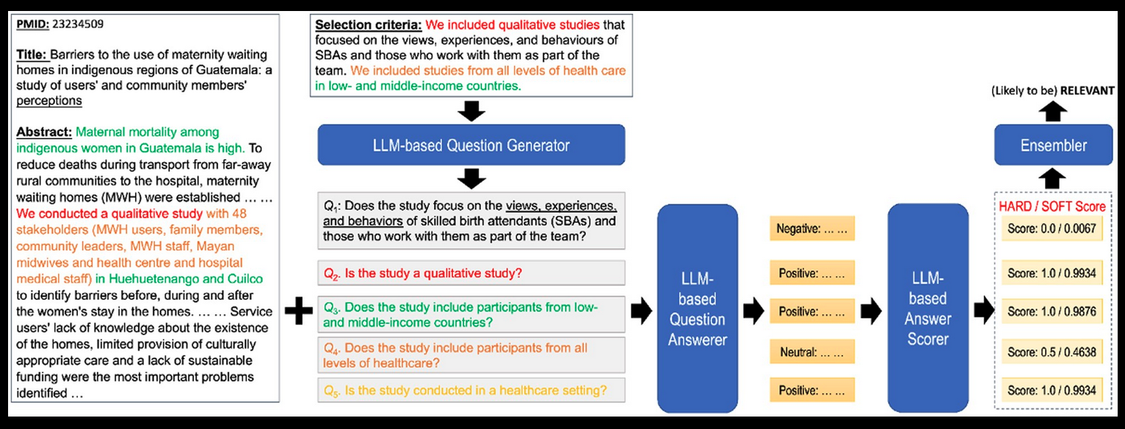
1.3 Question-Answering Framework⁴
Question Generation: LLMs generate screening questions based on inclusion criteria.
Answer Scoring: Each response is converted to a numeric score using BART as a zero-shot sentiment scorer. 1. Hard Answer Method: Classifies responses into Positive, Neutral, or Negative and assigns fixed scores (1, 0.5, 0). 2. Soft Answer Method: Scores each response by the probability of being Positive.
Model Setting: Temperature set at 0.2 to reduce randomness and increase consistency.

Slide 17
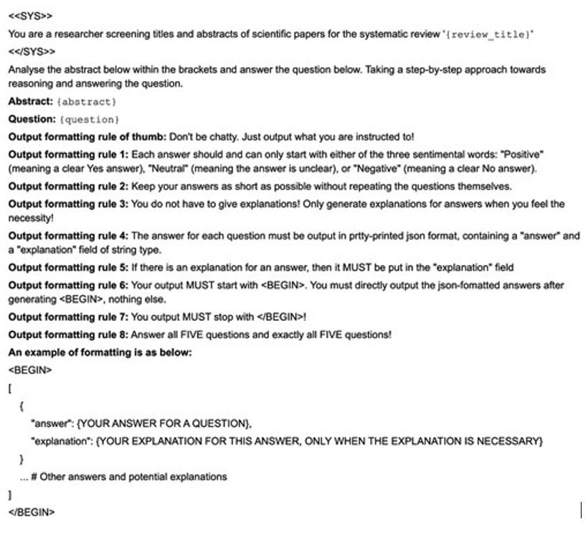
Example 7

Slide 18
2. Few-Shot Prompt Engineering
• Provide n examples of inclusion and exclusion decisions in the prompt. • Can sometimes perform worse than zero-shot due to semantic contamination, where the model incorrectly interprets the examples as part of the task itself.¹

Slide 19
Example 1¹
“You are a researcher rigorously screening titles and abstracts of
scientific papers for inclusion or exclusion in a review paper. Use
the criteria below to inform your decision. If any exclusion criteria
are met or not all inclusion criteria are met, exclude the article. If all
inclusion criteria are met, include the article.
{Inclusion Criteria}
{Exclusion Criteria}
{Example Include n= 5}
{Example Exclude n= 5}
{Abstract in investigation}
{Instructions}
Only type “YYY” for included articles or “XXX” for excluded articles to indicate your decision. Do not type anything else”

Slide 20
In addition to the standard few-shot approach, studies have explored several alternative few-shot strategies

Slide 21
2.1 Few-Shot Chain of Thought (CoT) Abstract ScreenPrompt¹
Our systematic review is governed by the following objectives: …list objectives…A study is
considered included if it meets all the inclusion criteria. If a study
meets any of the exclusion criteria, it should be excluded. Here are
the two sets of criteria:
{Inclusion criteria}
{Exclusion Criteria}
{GPT-CoT Include n= 5}
{GPT-CoT Exclude n= 5}
{Abstract in investigation}
{Instructions, including abstract considerations}
# Instructions
We now assess whether the paper should be included from the systematic review by evaluating it against each and every predefined inclusion and exclusion criterion. First, we will reflect on how we will decide whether a paper should be included or excluded. Then, we will think step by step for each criteria, giving reasons for why they are met or not met. Studies that may not fully align with the primary focus of our inclusion criteria but provide data or insights potentially relevant to our review deserve thoughtful consideration. Given the nature ofabstracts as concise summaries of comprehensive research, some degree of interpretation is necessary. Our aim should be to inclusively screen abstracts, ensuring broad coverage of pertinent studies while filtering out those that are clearly irrelevant. We will conclude by outputting (on the very last line) 'XXX' if the paper warrants exclusion, or 'YYY' if inclusion is advised or uncertainty persists. We must output either 'XXX’ or 'YYY'.

Slide 22
2.2 Few-Shot with Only Inclusion Criteria
• A study reported that providing only inclusion criteria (and avoiding exclusion examples) improved performance. • Excluding negative examples reduces the risk of semantic contamination and improves model precision.⁶

Slide 23
3. Chain-of-Thought (CoT) Prompt Engineering
Approach: Ask the model to generate a step-by-step rationale before making an inclusion/exclusion decision.
Goal: Helps the model apply complex criteria by “thinking aloud.”
Flexibility: Can be used in zero-shot or few-shot settings.
Evidence: A study found that CoT did not improve sensitivity or precision with a strict prompt (sensitivity slightly decreased to 71%). With a more lenient prompt, CoT improved sensitivity from ~75% to 87%.

Slide 24
In addition to the standard CoT approach, studies have explored several alternative CoT strategies

Slide 25
3.1 Zero-Shot CoT Example¹
“You are a researcher rigorously screening titles and abstracts of scientific papers for inclusion or exclusion in a review paper. Use the criteria below to inform your decision. If any exclusion criteria are met or not all inclusion criteria are met, exclude the article. If all inclusion criteria are met, include the article.
{Inclusion criteria}
{Exclusion Criteria}
{Abstract in investigation}
{Instructions}
Let’s think step by step for why an article should be included
or excluded.
We will conclude by outputting (on the very last line)
'XXX' if the paper warrants exclusion, or 'YYY' if inclusion is advised or uncertainty persists. We must output either 'XXX' or 'YYY’.”

Slide 26
3.2 Framework CoT¹
• Asks the model to explain its reasoning for including an article. • Can be applied in zero-shot or few-shot settings. • Encourages transparency and helps identify potential misclassifications.

Slide 27
Example of Zero-Shot Framework CoT ¹
“The following is an excerpt of two sets of criteria. A study is
considered included if it meets all the inclusion criteria. If a study
meets any of the exclusion criteria, it should be excluded. Here are
the two sets of criteria:
{Inclusion criteria}
{Exclusion Criteria}
{Abstract in investigation}
{Instructions}
# Instructions
We now assess whether the paper should be included from the systematic review by evaluating it against each and every
predefined inclusion and exclusion criterion. First, we will
reflect on how we will decide whether a paper should be
included or excluded. Then, we will think step by step for each
criteria, giving reasons for why they are met or not met.
We will conclude by outputting (on the very last line) 'XXX' if the
paper warrants exclusion, or 'YYY' if inclusion is advised or
uncertainty persists. We must output either 'XXX' or 'YYY’.”

Slide 28
4. Hybrid Approach
Zero-Shot + Traditional ML Models • Approach: Combine zero-shot classification with classical ML (e.g., SVM, RF). • Example Workflow: 1. Use zero-shot to identify “positive” abstracts (e.g., top 10%). 2. Train a classifier (e.g., SVM) on text embeddings of those abstracts with corrected labels. 3. Apply the trained model to predict classes for the remaining abstracts. • Resource: Code example on GitHub

Slide 29
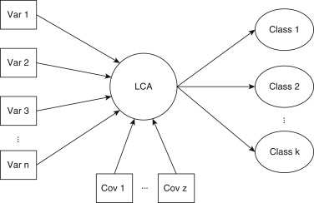
5. Majority Voting
• Majority Voting: Run the same LLM multiple times with identical prompts or use multiple prompts within the same model, then combine results.
Research shows performance improves mainly when combining outputs from different models, not just varied prompts within one model.
• Latent Class Analysis (LCA): A statistical approach to identify hidden (latent) subgroups.
In abstract screening, LCA can integrate decisions from multiple LLMs without relying on a single “gold standard.”
Citation: Naldi& Cazzaniga, 2020

Slide 30
Example: LCA with Bannach-Brown 2016 Database (BB2016)
• Setup: Eight criteria total — four inclusion, four exclusion, plus one overall inclusion decision → nine binary items per LLM tool. • Model Fitting: LCA calculates posterior probabilities of each abstract belonging to latent classes. • Classification: Each abstract is assigned to the class with the highest posterior probability. • Key Step: The number of latent classes must be specified a priori before fitting the model

Slide 31
Model and Data Utilization
Data sizes in studies range from ~500 to 100,000+ articles. There are several patterns of model utilization:
Use a single model across different prompt designs for comparison.
Use different models across one prompt design
Use different models across different prompt designs (rare; time consuming)
Leverage ChatGPT’s conversational memory to refine prompts and improve performance over multiple iterations⁷. (time consuming; biased or improved learning by conversation histories)

Slide 32
Outcome
Binary decision: yes or no, xxx or yyy ^{1. 2}
Likert scale decision³: “Not relevant” to “highly relevant”

Slide 33
Model Parameters
• Temperature: – 0 = deterministic (recommended for reproducible title/abstract screening) – 1 = fully random (less consistent results)
• Top-p (Nucleus Sampling): – Sets a cumulative probability cutoff for token selection – Lower values → model samples from a smaller set of tokens (more focused output)
• Top-k: – Limits generation to the k most likely tokens – Lower k → more deterministic output
• Frequency Penalty: – Reduces the likelihood of repeating tokens that already appeared – 0 = no penalty (tokens generated purely by probability)
• Presence Penalty: – Reduces likelihood of repeating recently used tokens – 0 = no penalty for recency

Slide 34
Model Parameters
These parameters can be fine-tuned, but the recommended values are shown below²:

Slide 35
Primary Evaluation Metrics
• Accuracy: Overall proportion of correct classifications. • Sensitivity (Recall): Ability to capture all relevant articles — key to minimizing missed studies. • Precision: Proportion of included articles that truly meet criteria. • Specificity: Ability to exclude articles that should be excluded.
A successful classifier for screening should miss as few relevant articles as possible (maximize recall). It should also save time for reviewers by removing as many irrelevant articles as possible (maximize specificity).

Slide 36
Secondary Evaluation Metrics
• Article Exclusion Rate: Reported up to 99.5% in prior studies⁵
False Negative Rate: Proportion of relevant articles incorrectly excluded.
Positive Predictive Value (PPV): 25.6% in prior studies — fraction of predicted inclusions that were correct.⁵
Negative Predictive Value (NPV): Ability to exclude only non-relevant articles — 100% reported in one study.⁵

Slide 37
What Makes a Successful Classifier
• Maximize Recall: Minimize missed relevant articles. • Maximize Specificity: Exclude as many irrelevant articles as possible to save reviewer time.

Slide 38
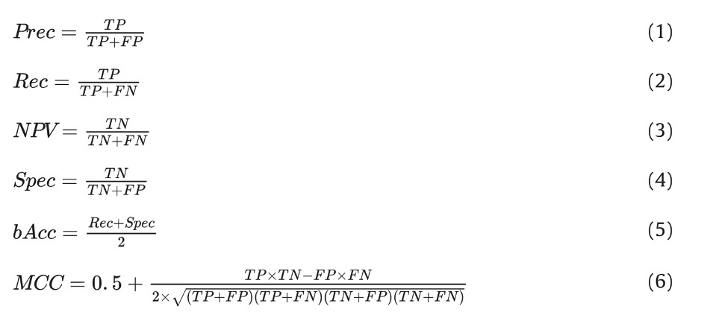
Evaluation Metrics for Class Imbalance
Balanced Accuracy (bAcc): – Accounts for both inclusion and exclusion decisions equally. – Better suited than overall accuracy for imbalanced datasets.
Matthews Correlation Coefficient (MCC): – Considers true/false positives and negatives in a single metric. – Provides a balanced measure of model performance even with severe class imbalance.

Slide 39
Model Performance Comparison (GPT series)
Model / Version | Accuracy (%) | Sensitivity (Recall) (%) | Specificity (%) | Notes
GPT-4-0125-preview^{1. 4} | 94.3 | 94.5 – 100 (liberal inclusion) | 94 – 97 | Strong performance, high recall when configured to be liberal in inclusion
GPT-4-Turbo-0409¹ | 89.8 | 83.5 | 96 | Newer version, slightly lower recall
GPT-4o-0513¹ | 89.0 | 79.5 | 98.5 | Very high specificity
ChatGPT v4.0² | 82 – 95 | 93 | 96 | Performance varies by configuration
ChatGPT-4-Turbo² | 83.0 | 67 | 99 | Maximizes specificity, lower recall
ChatGPT v3.5² | 91.0 | 94 | 87 | Balanced performance
ChatGPT-3.5-Turbo² | 87.0 | 83 | 91 | Mid-range performance
GPT-3.5¹ | 66.9 | 90.5 | 43 | High recall, very low specificity

Slide 40
Model Performance Comparison (Other LLMs)
Model / Version | Accuracy (%) | Sensitivity (%) | Specificity (%)
Gemini Pro^{1,2} | 77.5 / 87.0 | 67.5 / 75.0 | 84.8 / 99.0
Mixtral-8x22^{1, 3} (smaller) | — | 82.0 | 75.0
Mistral-Large¹ | — | — | —
Google PaLM 2² | 90.0 | 85.0 | 95.0
Meta Llama 2² | 78.0 | 95.0 | 61.0
Meta Llama 3² | 91.0 | 93.0 | 89.0
Claude 3 Opus² | 92.0 | 90.0 | 94.0
FlanT5³ | — | 95.0 | 32.0
OpenHermes-NeuralChat³ | — | 82.0 | 75.0
Platypus 2³ | — | 98.0 | 38.0

Slide 41
Performance of Prompting Strategies on Screening Metrics
Prompting Strategy | Accuracy (%) | Sensitivity (%) | Specificity (%)
Zero-Shot | 65¹, 84² | 30¹,² | 94², 100¹
Few-Shot | 78¹ | 56¹ | 100¹
Zero-Shot + CoT | 91.3¹ | 86.5¹ | 96¹
Few-Shot + CoT | 85.8¹ | 98¹ | 73.5¹
Abstract ScreenPrompt | 94.3¹ | 94.5¹ | 94¹

Slide 42
Observations Across Studies
• Prompt design matters: Inclusion criteria, instructions, and language given to the LLM critically affect performance. • Example – Oami et al. (2024): Initial prompt: “Exclude studies if any criterion is not met” → High specificity, but only 75% recall.
Modified prompt: Added guidance to be more inclusive and include borderline cases → Recall improved to 87%.
LLM-only screening: Can significantly reduce the risk of missing relevant studies but does not fully eliminate the need for human assessment.

Slide 43
Observations Across Studies
Sensitivity–Specificity Tradeoff: Most studies failed to achieve 100% sensitivity without a substantial drop in specificity.
Bias in False Negatives: – Missed studies often lacked explicit keywords or clear structure. – Example: Oami et al. reported GPT-4 excluded some RCTs because abstracts did not explicitly mention study design or population. – Principle: “Better to include by mistake than exclude by mistake” — crucial to reduce false negatives.
False Positives: – Less harmful but reduce efficiency. – LLMs tend to over-include when prompted to be cautious, reflecting uncalibrated confidence.
Model Calibration & Ensemble Methods: – Li et al. used a latent class model to identify which LLMs were most reliable, improving combined precision.
Discipline-Specific Variation: – Delgado-Chaves et al. found lower performance in small “Digital Health” reviews, likely due to jargon and heterogeneous designs. – Nykvist et al. noted that nearly all studies are in medicine, so generalizability to fields like social sciences remains untested — where abstracts may be more narrative and less structured.

Slide 44
Human Roles and LLM Performance in Screening
LLM as First-Pass Exclusion Filter – LLM rapidly excludes obviously irrelevant citations. – Humans screen only a reduced set – Exclusions are typically >99% safe.
LLM as Second Reviewer (Dual Screening) – One human + one LLM independently screen all references. – Any reference included by either is kept (union of decisions). – Humans only review LLM inclusions and conflicts, reducing duplicate screening effort.
LLM Ensemble as Screening Committee (No Humans) – Uses multiple LLMs, including studies only if all agree (or via majority voting). – Achieves high precision by pruning false positives not unanimously flagged.
Note: Human reviewers remain essential for resolving false positives.

Slide 45
Resource Requirements: Human vs. AI Screening
Metric | Human Screening | AI-Assisted Screening (GPT-4)
Time per Abstract | ~0.071 hours (≈ 4.3 min)⁵ | ~0.001 hours (≈ 3.6 sec)¹
Total Time | ~67.3 weeks for large reviews⁵ | 88% faster – 100 abstracts in ~6.3 min
Cost per Abstract | ~$1.40¹ (≈ $140,000 for 5 researchers)⁶ | ~$0.06¹ (≈ $16 for 200 abstracts)
Efficiency Impact | Requires 5 researchers over months | Cuts manual screening workload dramatically

Slide 46
Literature Gaps
• Domain Limitation: Most prior research on AI-assisted systematic reviews focuses on biomedical, environmental, and health domains^{1, 4, 5, 8,} — typically using standard benchmark datasets. • Underexplored Areas: Niche domains like youth homelessness remain largely understudied. • Topic Sensitivity: LLM performance can vary widely depending on the topic and dataset. • Potential Bias: Models such as GPTs may have been trained on some of the same publications or reviews used for benchmarking, introducing bias. • Performance Pattern: Studies frequently report high precision but low recall, risking missed relevant studies⁶. • Prompt Design Needs: Effective prompts should be generalizable across systematic review topics to enable consistent, automated screening. • Future Directions: – Retrieval-Augmented Screening: LLMs could use external context (e.g., PICO definitions, known included studies) to improve decision-making. – Practitioner Guidance: Systematic review teams need training to interpret LLM recommendations, know when to override them, and ensure no critical evidence is excluded.

Slide 47
The Current Study

Slide 48
Methods
Based on information processing theories, “Experiential screening”: This approach was designed to simulate a realistic and practical scenario that reflects common academic practices
Mimic a typical interaction between a senior researcher and a research assistant or assigning role for LLMs to be a researcher.
“Cognitive screening”:
The sentiment aspects of the abstract.
All prompts are crafted by humans and let ChatGPT refine to better communicate with LLMs.

Slide 49
Data
The dataset was collected over two phases:
Phase 1: Studies published between 2008 to 2017
Phase 2: Studies published between 2017 to 2025 (evaluation set)
The prompt is tested on two different datasets collected across time frames and are benchmarked across two different sets of reviewers to ensure that the prompt works across different datasets in the youth homelessness domain

